Slide 1
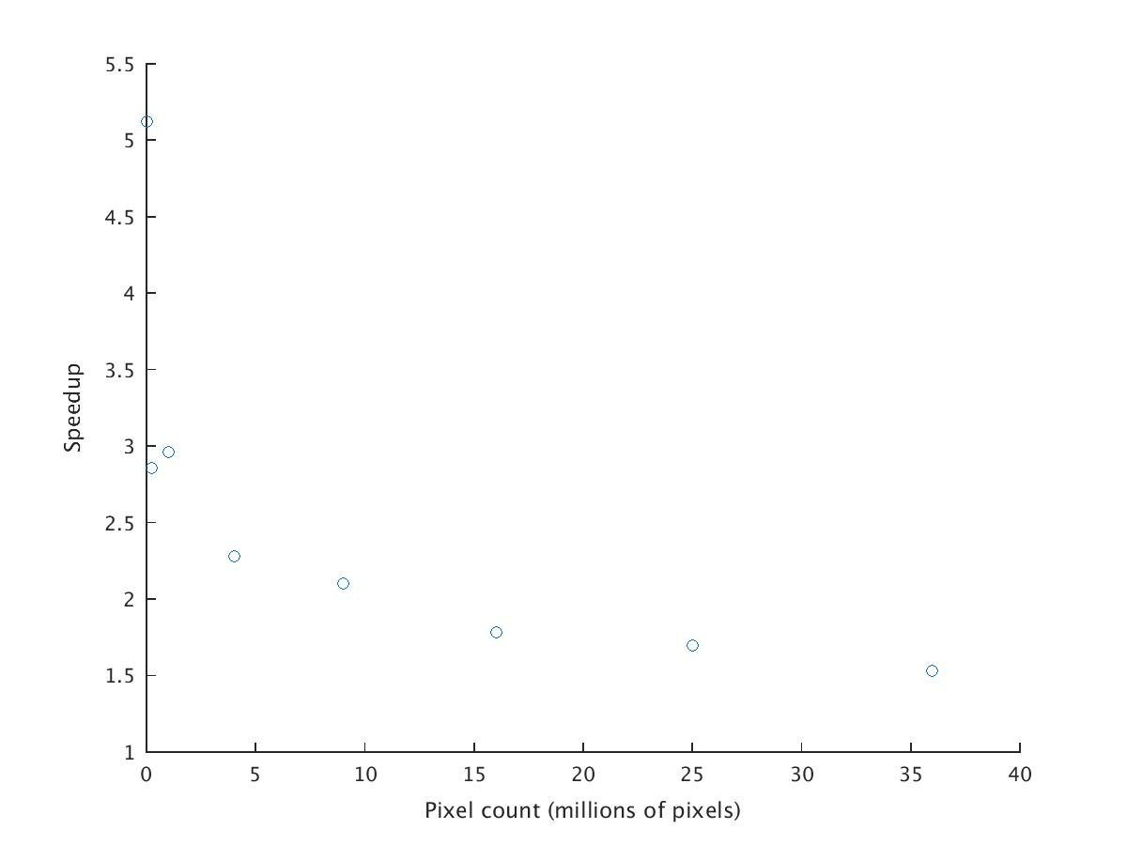
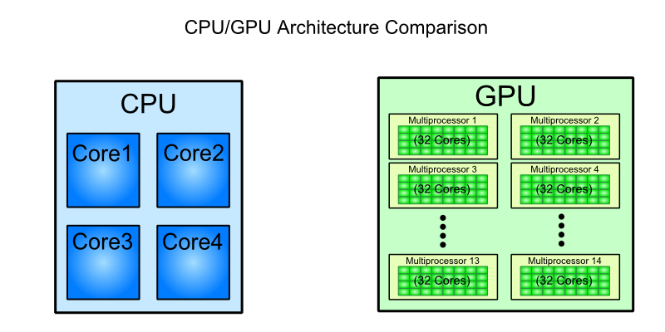
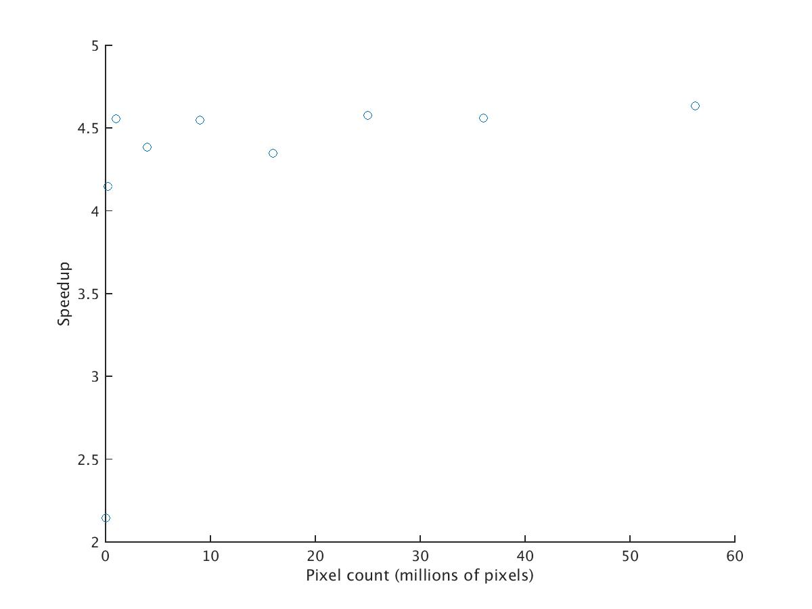

GPU-Accelerated Parallelization of Common Computer Vision Applications
Emilio Del Vecchio, Kevin Lin, Senthil S. Natarajan
I. Introduction
II. FUS Gene Model
I. Introduction
-Graphics Processing Units (GPU’s) have recently become popular for their ability to parallelize computations and achieve much greater efficiency as compared to the serial implementation of a CPU.
VS
Fig 1. The GPU’s parallel architecture allows it to parallelize massive computations.
-Our objective is to utilize the GPU’s ability to accelerate computer vision applications like edge detection, motion tracking, and face recognition. Due to the proliferation of computer vision in many regular tasks, this affords us an opportunity to explore how to make such common tasks more efficient.

